Slide 1
Storage Gateway

Slide 2



Storage Gateway
Hybrid solution
Connecting storage between On-Premise and AWS Cloud
Eliminates challenges
High Network Cost
Long transfer times
Security concerns

Slide 3

Storage Gateway types
Three storage Interfaces supported
File
Volume
Tape
File Gateway
Uses NFS file protocol to fetch files
Volume Gateway
Block storage. Provides local iSCSI disk
Virtual Tape Library
Virtual media changer, Virtual tape etc
Notes:
The basic concept in Computer Science is a filesystem. A filesystem defines the layout of files in a storage device. They have a well defined hierarchy. For example in ext3 and similar filesystems there is a root directory (/) which is the very first directory. It has multiple branches. In Windows we have the concept of folders which are also an hierarchy. Folders are all within a drive and folders can contain files or other folders. In case of Block Storage, a filesystem is built over a raw device. In case of File storage, a filesystem is exposed which can be mounted.
We can say that the objects exists in a flat name space. In other words, there is no hierarchy involved here. The lack of hierarchy is advantageous when it comes to Internet scale storage. In case of a filesystem, a separate space stores the meta data of the filesystem (super bock, inode data etc in case of ext2, ext3 etc) Accessing a file in a hierarchy which is deep and when we are talking about humungous number of files is problematic. Object store avoids this problem by not having an hierarchy. The meta data of the object is stored along with the object. Every object gets an Object ID and all the needs to stored in the Object ID and its location. It is by using Object Store that Amazon has been able to store trillions of objects in its S3 Storage service.
In case of Objects, Metadata relating to the object is stored within the object itself. An Object ID is used to retrieve the object

Slide 4
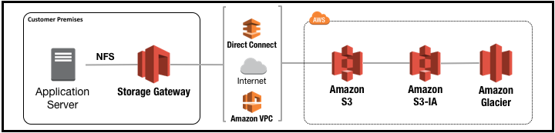

File Gateway
Image Source: AWS Documentation

Slide 5
How File Gateway works
Download virtual image for file storage gateway
Activate the file storage gateway
Expose the S3 buckets which must be accessed as filesystem
User sees a filesystem while gateway writes files asynchronously to S3

Slide 6
Volume Gateways
Cached Volume Architecture
Stored Volume Architecture

Slide 7
How Cached Volume works
S3 is the primary data store
Frequently accessed data cached locally
Attached to on premises system as iSCSI disk
Max disk size is 32TiB
Each gateway supports upto 32 volumes
Total storage capacity of 1 petabyte

Slide 8
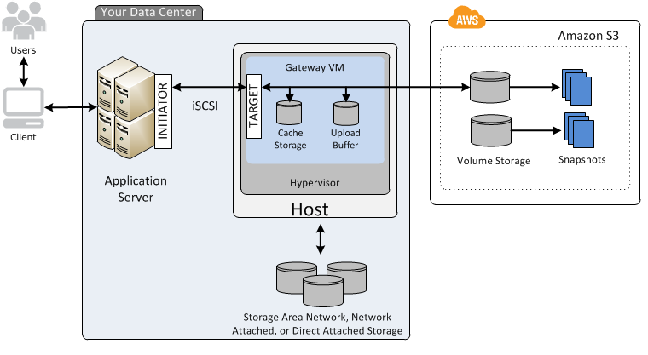
Cached Volume Gateway
Image Source: AWS Documentation

Slide 9
How Stored Volume works
Primary data stored locally
Asynchronous backups taken
Low latency access to on premises apps
Maximum disk size of 16GiB
Support for upto 32 volumes per gateway
512GiB total volume

Slide 10
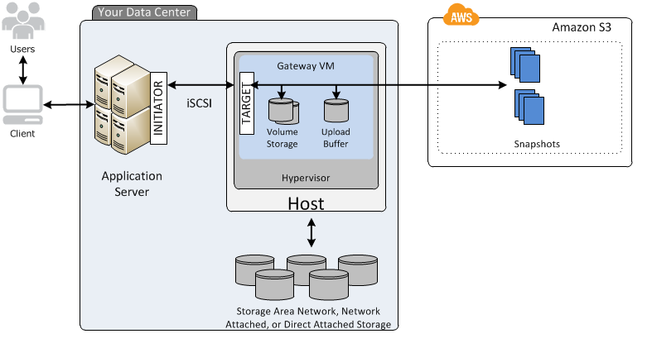
Stored Volumes
Image Source: AWS Documentation

Slide 11
How Tape Gateway works
VTL Solution
Virtual Tape Library
Allows usage of existing tape based backup solution
Data backed up to virtual cartridges
Archival tapes stored in Glacier

Slide 12
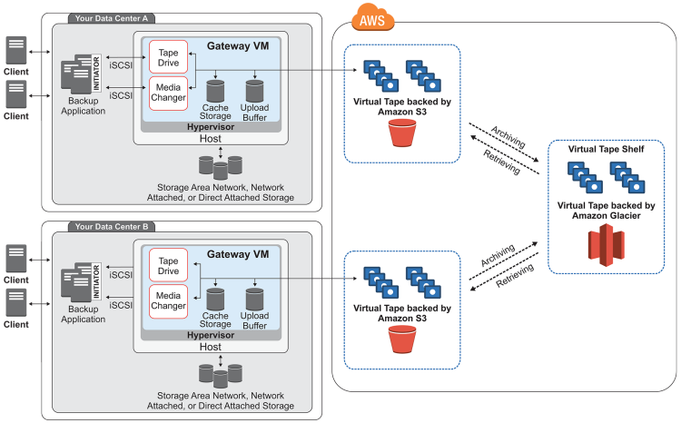
Tape Gateway
Image Source: AWS Documentation

Slide 13

Thank You
suresh@cloudsiksha.com

